Slide 1
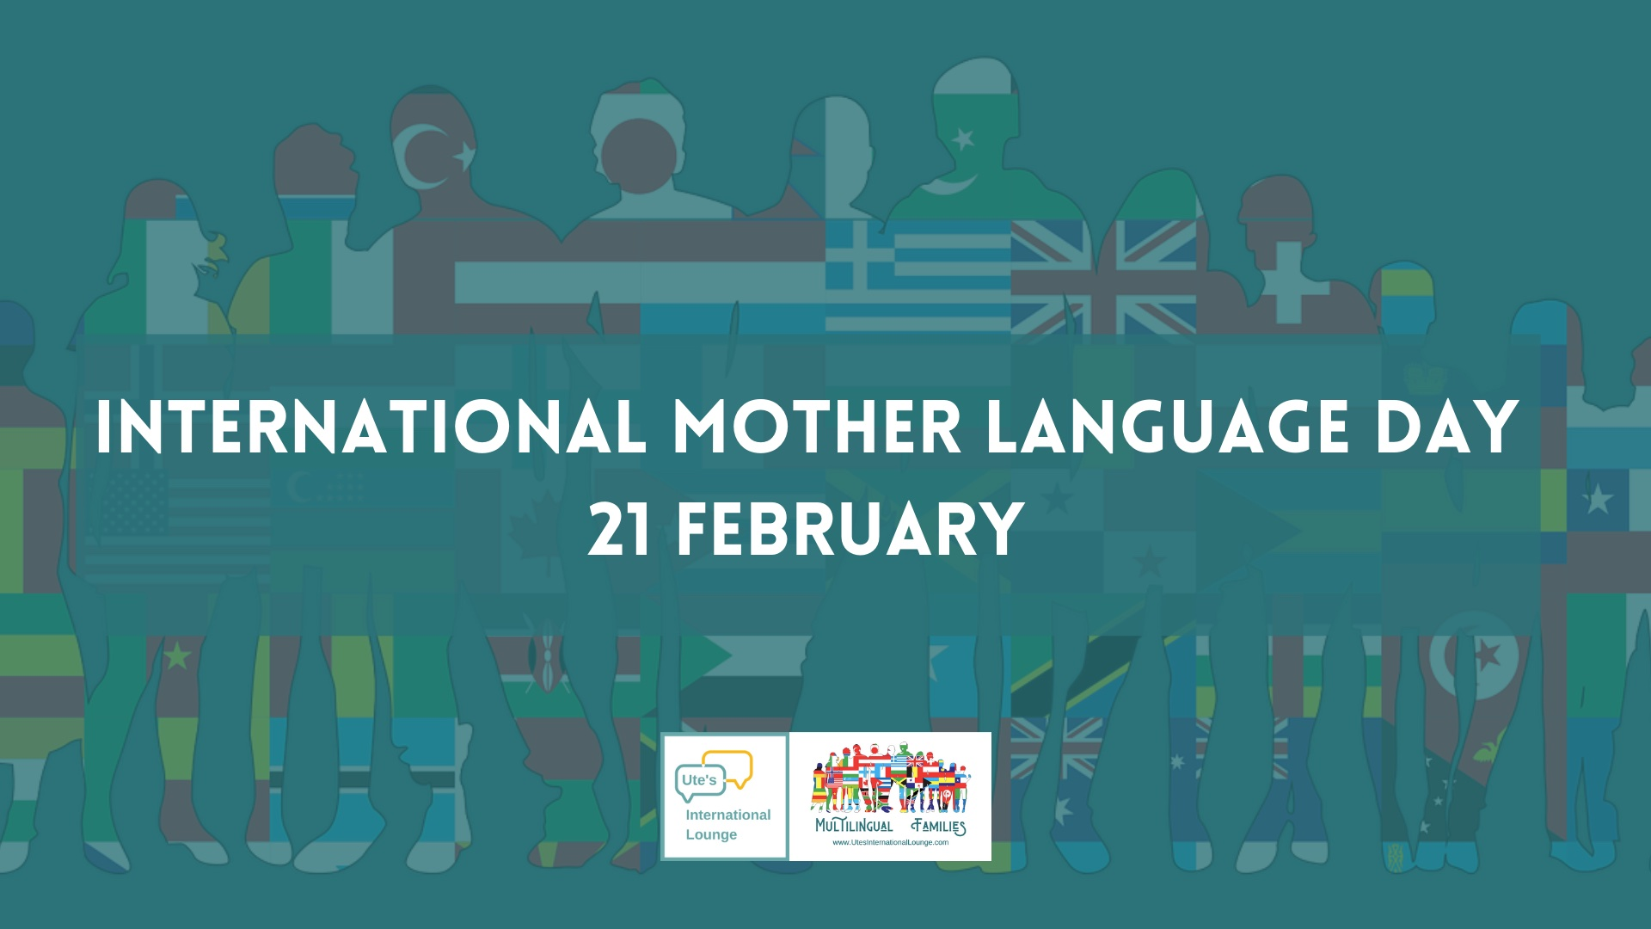
International Mother Language Day
Monday 21st February
Rights Respecting steering group
Created by William and Shanaya in Year 6
Presented by William, Reece and Chloe

Slide 2
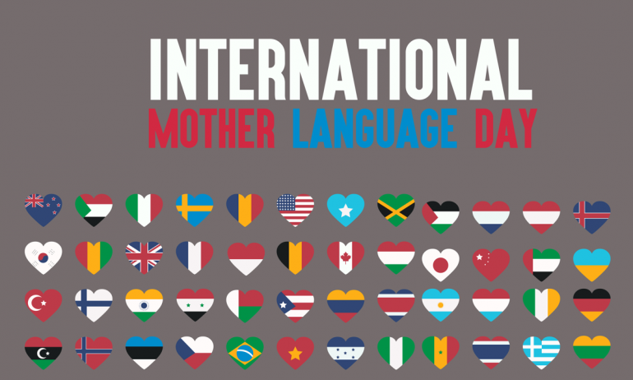
How was it made?
This day is celebrated on the 21st of February.
This day is celebrated because in 1952 four innocent students were killed during a difference of opinion between the languages spoken by Pakistan and Bangladesh.

Slide 3
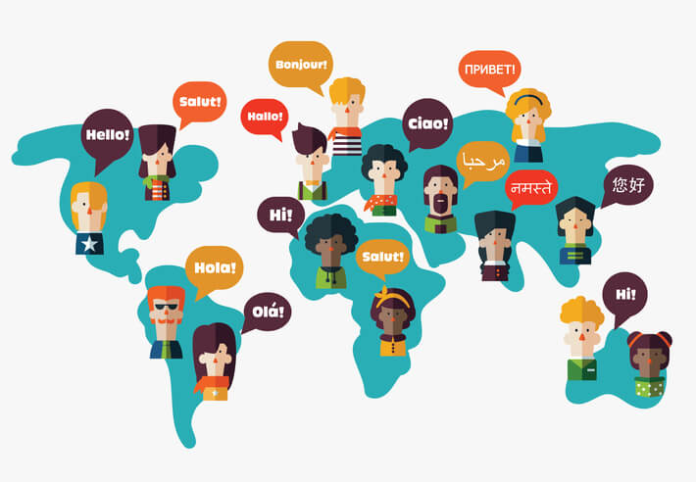
Why is it important?
There are estimated to be about 6000 languages spoken around the world.
As some of these languages are more widely spoken,
Some disappear.
How many languages can you think of?

Slide 4
When did it first take place?
  The first international Mother Language Day took place in the year 2000.

Slide 5
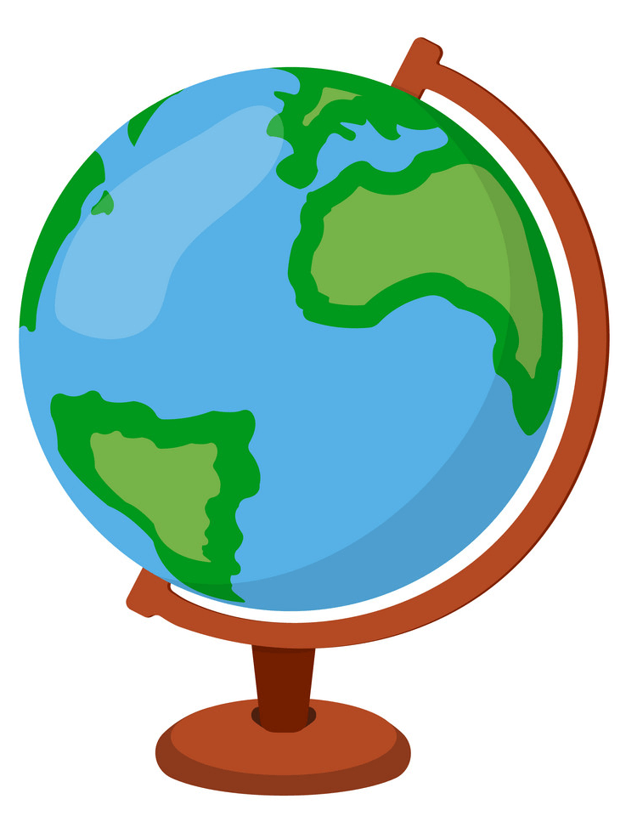
Which languages are endangered?
There are many languages which are currently in danger of becoming extinct. Some examples of endangered languages are:
Choctaw
This indigenous language is spoken in the United States, in states such as Louisiana, Mississippi and Oklahoma. It has about 9500 speakers.
Kalmyk
This language, which is spoken in Russia, was apparently
used by George Lucas as the base for a language used in
one of the Star Wars films.
Quechua
This language is spoken in Bolivia and Peru. It was the main
language of the Incas.
indigenous - A language, or culture that is from the country where it is found, rather than having been moved there from somewhere else.

Slide 6
Mother Language Day
Selwa’s story
Let me tell you about my family. Ten years ago, when I was just a baby, my parents emigrated from Morocco to Spain. My two brothers and my sister were born in Spain. My father is a doctor and my mother is a teacher. Well, that’s what they did in Morocco. When my parents came to Spain, they couldn’t find jobs because their qualifications weren’t from Spanish universities. Also, the main language spoken in Morocco is Arabic, and in Spain they had to learn Spanish. My Papa worked in a hospital, but he was cleaning the floors. Papa managed to do further studies until he had qualifications that let him practice as a doctor again. Mama always says that it was a struggle but she is so glad because my Papa only ever wanted to be a doctor.

Slide 7
Mother Language Day
After we had been here for a few years, Papa arranged for his mother to join us. His father had already died and Nana was on her own. Now we all live together in one apartment. I don’t remember much about Morocco, so Spain is really home for me. My brothers and sister wouldn’t even think about living anywhere else – this is all they’ve ever known. I know it’s different for Mama and Papa. Papa has made lots of friends through his work and his Spanish is almost as good as mine. Mother’s friends are mostly Moroccan and her Spanish is limited to doing the shopping and greeting neighbours. Nana only speaks Arabic.

Slide 8
Mother Language Day
I think I’ve only ever heard her say “hello”, “thank you”, “goodbye”, “how much” and “too much” in Spanish. Nana says she’s too old to learn anything new. I’m proud of coming from Morocco and of being Spanish. Does that sound strange? I like things about both cultures. I love both languages – Mama and Nana talk to me in Arabic. It upsets me when teachers tell me not to speak Arabic at school, like it’s a bad language or something. I have friends who are completely Spanish and friends who are a bit of a mix like me. They treat me the same. It tends to be children that don’t know me, or ignorant adults who offend me.

Slide 9
Mother Language Day
Sometimes they don’t mean it. They say, “You’re not Spanish are you, where are you from?” I want to say, “Actually I am Spanish, but I’m originally from Morocco.” I think if I was white, they wouldn’t say these things. I’ve talked to my father about racism. He tells me that sometimes patients don’t want to see him because he’s black. That upsets me but it’s their loss because he is the best doctor in his clinic.

Slide 10
Languages
Your mother language is the language that you grow up learning, this is often the language of your home country.
This day promotes awareness of linguistic and cultural diversity and to promote multilinguism (speaking other languages)
Languages are the reason we are superior to other animals. They are the reason we can communicate with each other.
A language disappears every two weeks.
Languages are our heritage .
For most people there is one language that they need to learn as their mother tongue but for some children who are growing up in multilungial families they need to learn two or more language at the same time.

Slide 11
Technology
This year, 2022, the world is trying to celebrate mother language day by discussing the potential role of technology to advance multilingual education, these can include things such as google translator and other online facilities for people who are facing linguistic challenges.

Slide 12
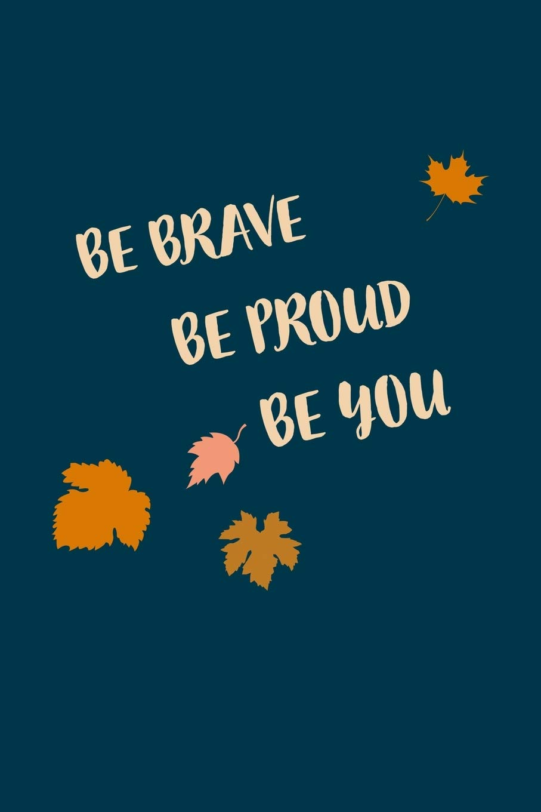
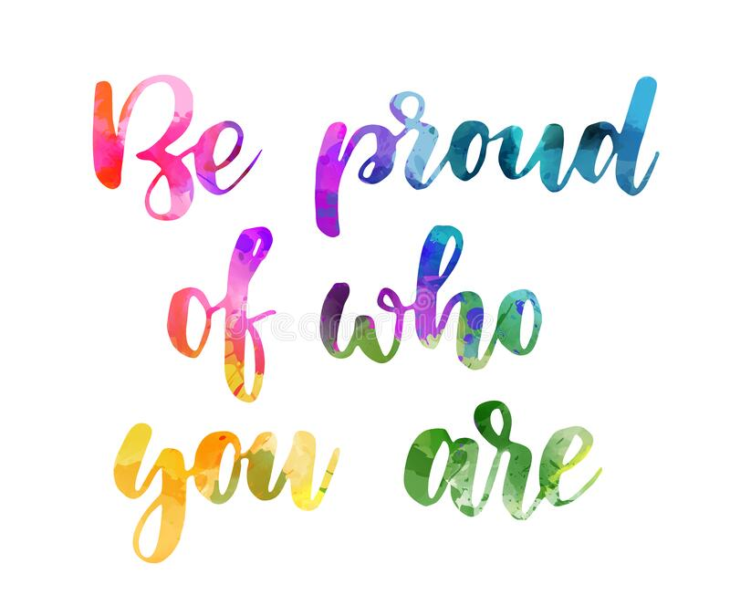
Be proud
Remember to be proud of who you are, your family, culture and the language that you speak.

Slide 13
What can you do?
This week, when you are talking about the Article of the Week as a class, please create a list / display of all the languages spoken in your class.
Maybe you could teach each other?
On Friday, we would like the Rights Respecting Steering Group to share the languages their class speaks.
Thank you

Slide 14

Rights Respecting Article of the week
What will this week’s article be?

Slide 15
Attendance and Punctuality
Who are the winners this week?

Slide 16
Attendance and Punctuality
Attendance –Archers
Punctuality – Castles

Slide 17
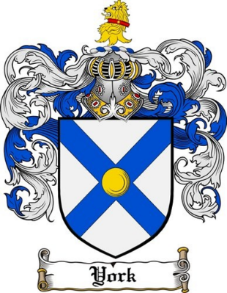


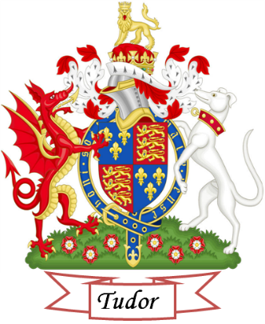
House points
Tudor –701
Windsor –1058
Stuart –585
York -628

