Slide 1

Rights Respecting Updates
Rights Respecting

Slide 2
We are going to stop the Right Respecting Certificates and have an Article of the week.
The Article of the Week is :
When you and your class talk about a specific article and do some activities about the article.
ARTICLE OF THE WEEK

Slide 3
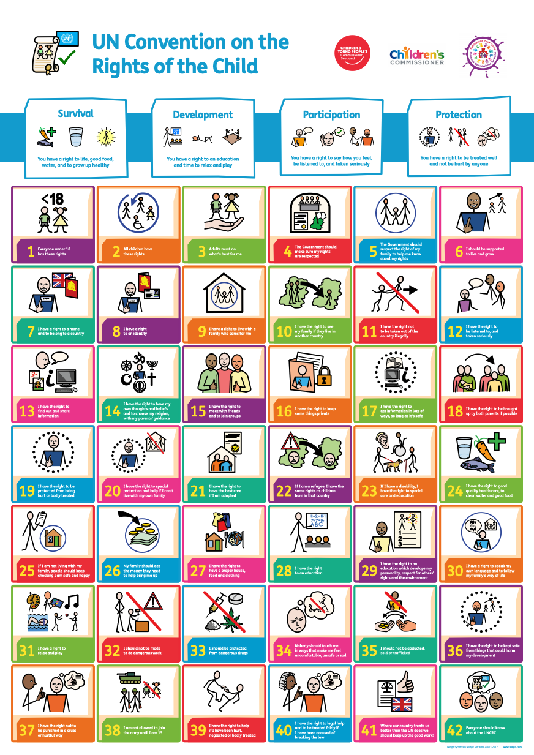
Next week’s article
Next week will be the first Article of the week.

Slide 4

What will happen?
Your class teacher will be sent a slide show linked to the Article.
We CANNOT tell you what the article will be as there is a guessing game at the start.
Sshhhh….Steering group knows next week’s already but are keeping quiet!

Slide 5
Unicef/Dawe
Notes:
Sehinemariam, 17, a grade 12 student attending classes via Radio which is one of the government’s initiative to support studying at home due to closed schools across Ethiopia.
Unicef/Tesfaye

Slide 6


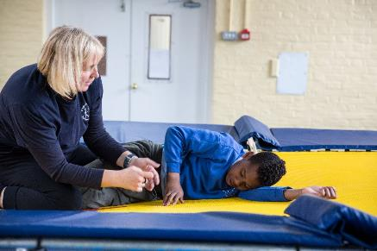
Guess the article
These pictures provide a clue to this week’s article.
Can you guess how they are linked together? Which article of the Convention do these pictures relate to?
Write down your thoughts or discuss with someone in your home.
BBC News
Unicef/Dawe
Accessible Icon Project

Slide 7
Display
The Article of the week will be displayed on a board outside Mrs Johnson’s office (orange room).

Slide 8
What next???
We would also like to have a full day each term for the whole school to focus on one of the Rights.
For example, we could spend a whole day celebrating World Religion Day.
The children could explore the different religions in their class and around the school including how this is celebrated!

