Slide 1

Rights Respecting Assembly 29/4/22
Created by Skye ,Evelyn, Rosie, Dexter, Josh, Shanaya and Duriel
Presented by Mia, Chloe, Reece, Tiziana and William

Slide 2
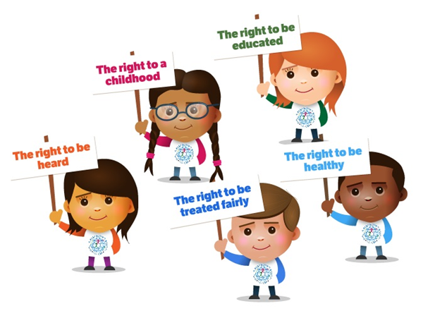
Why rights are important?
Rights are important because we need to share our thoughts and opinions.
We need rights to live, express ourselves, be free and enjoy ourselves.
Rights are here to help us choose between right and wrong. They allow us to have a say.

Slide 3
Article of the week
We need to learn about our rights. It gives us the opportunity to discuss rights in more detail so we can discuss these things with our class, friends and family.
Every Monday the display is changed.
Every week classes and rights leaders are meant to be discussing our articles. This allows for us to understand them more.

Slide 4
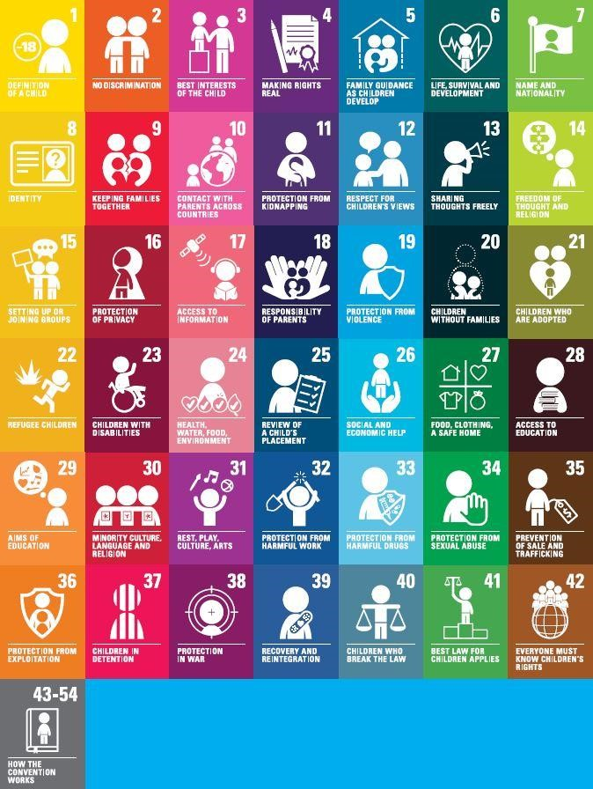
We are going to share some rights that we see as important to us at
Kingsway at the moment.

Slide 5

Article 28- Access to education
If we didn’t have any education then so many inventions we have and need in this day and time we wouldn’t have because no one would learn how to make them.
Everyone deserves to have an education because they need to learn new things and be prepared for adult life.

Slide 6
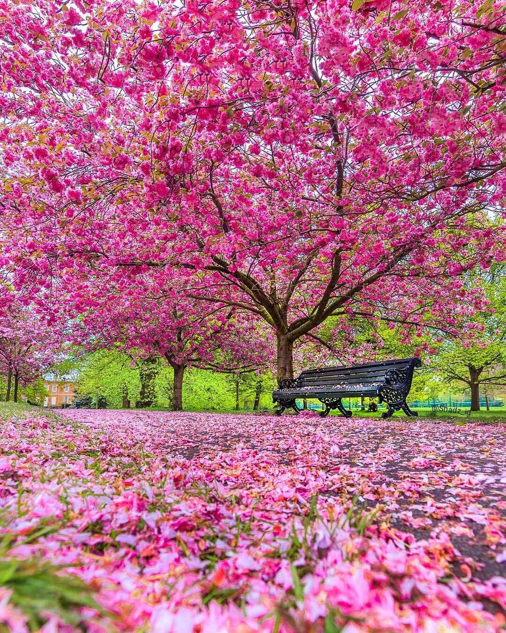
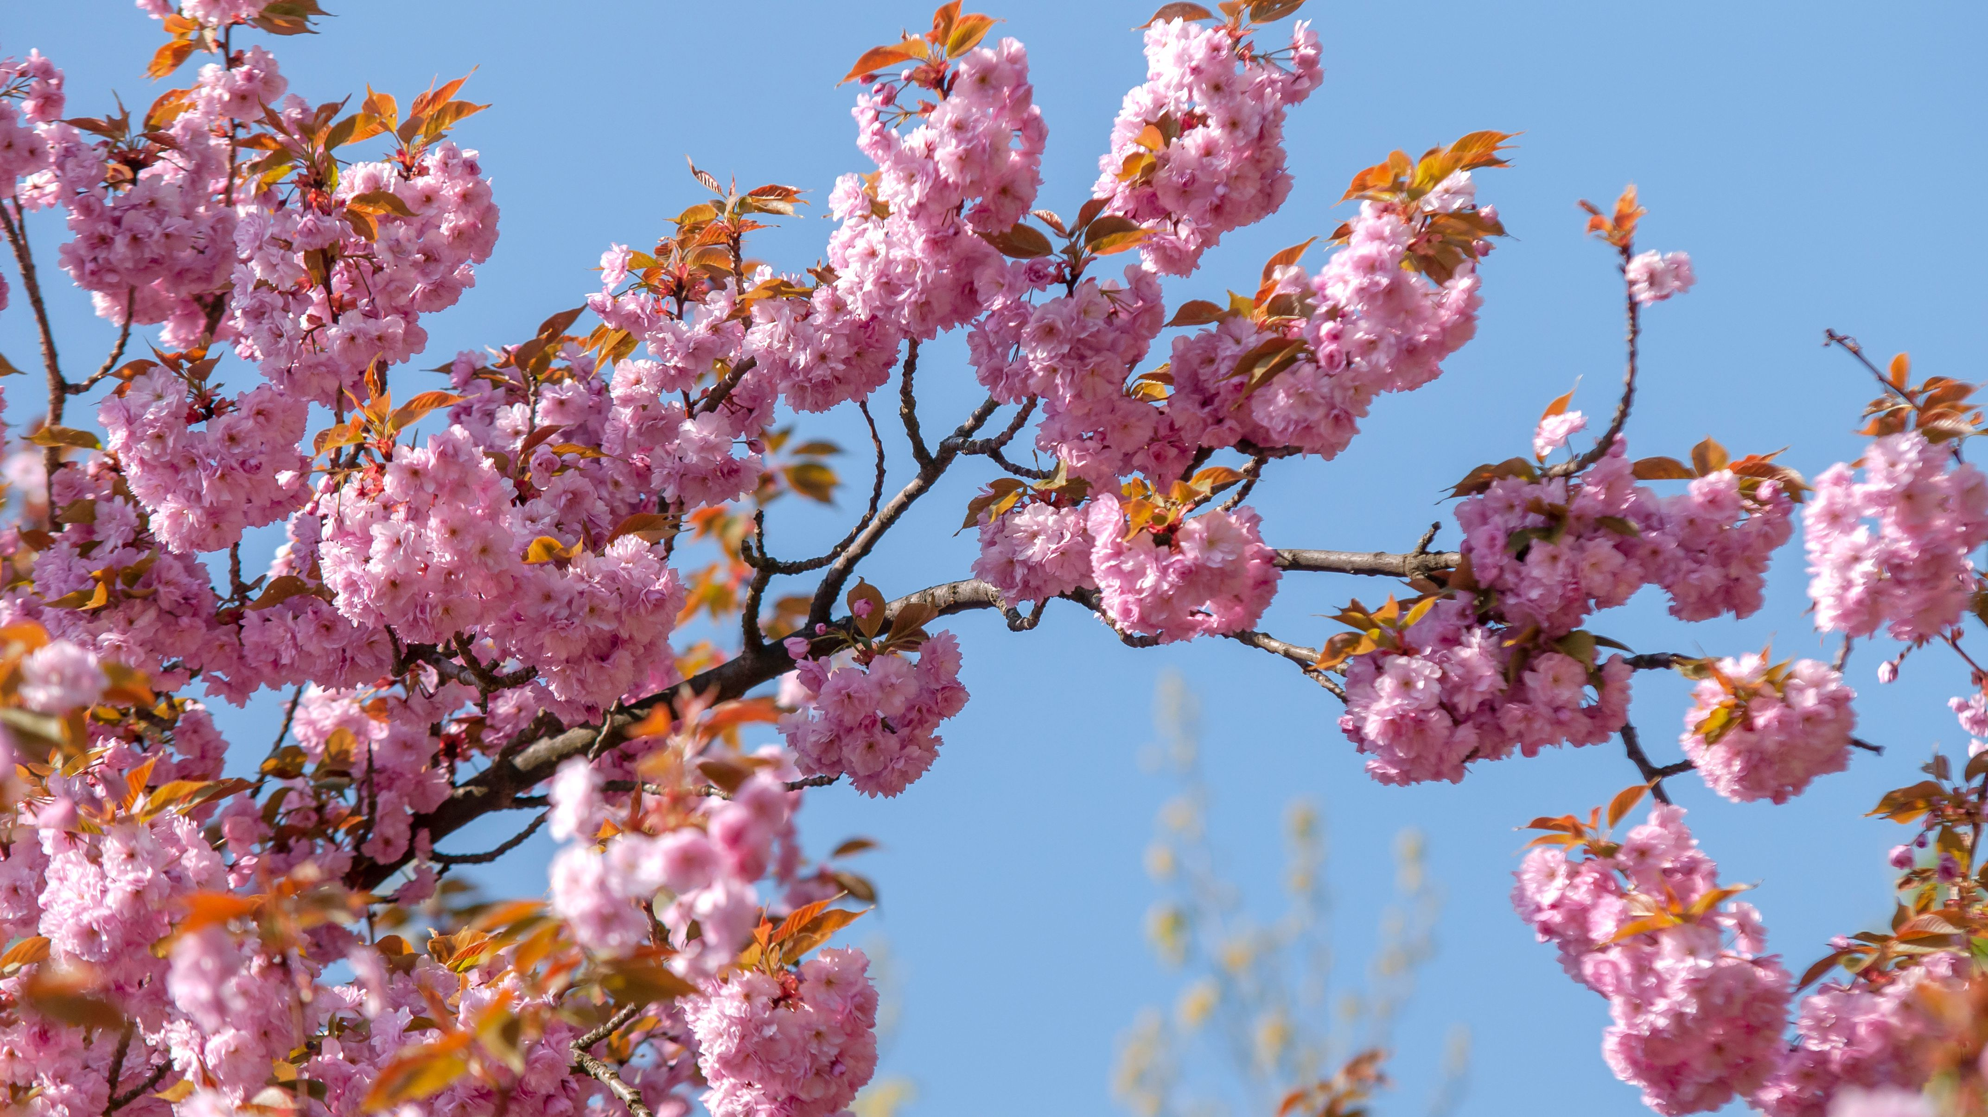
Article 24- Environment
The environment is good for your mental health, it makes you feel calm and happy. If we cut down too many trees, animals will lose their homes and habitats.
It is so sad how everyone is always picking the blossoms on the tree and the daisies and most people throw those flowers away which goes to a waste, its better to let them grow than have them die in your hand.
In this case little things can make a huge difference, see what you can do to make a difference this year.

Slide 7

Article 38- Protection from war
Unfortunately, some people think war is the only answer, as a result many people are forced to leave their home.
This can be quite traumatising for many people as well as tiring.
When people flee they might get seperated from family and friends and when people flee they need to start a fresh.
Some young adults are giving up their education and are being made to fight at war.
We offer our support to Ukraine and are grateful for Joanie and Ella who are selling peace bracelets to raise money for Ukraine. They will be selling these on Wednesday and Friday.

Slide 8
We all have rights
Remember we all have rights. This means we should not be afraid to speak out for what is right.

