Slide 1


Slide 2
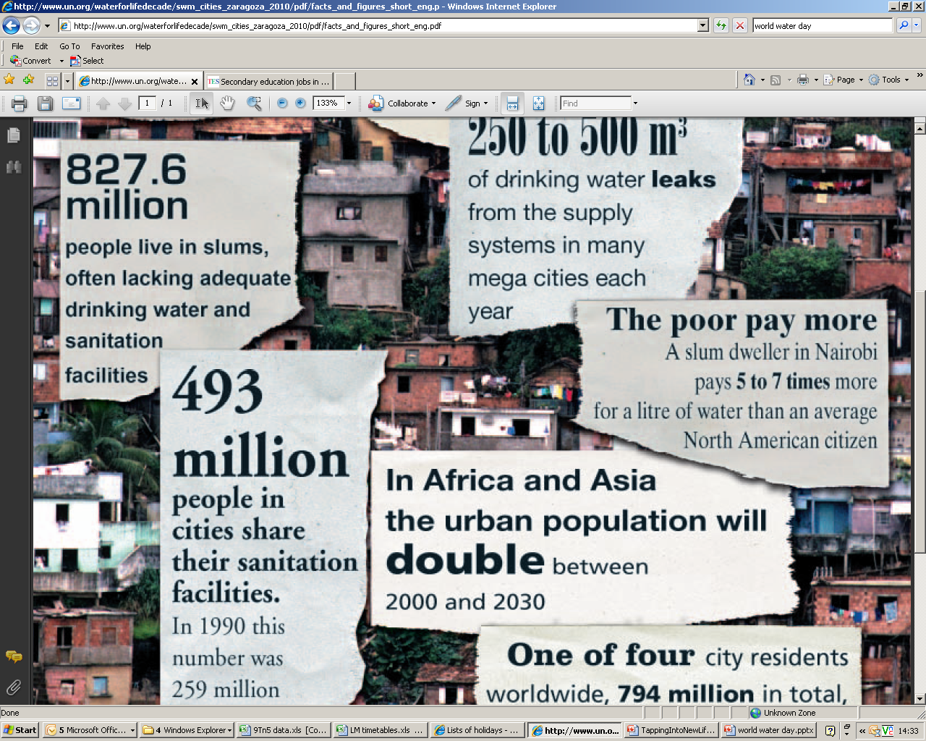
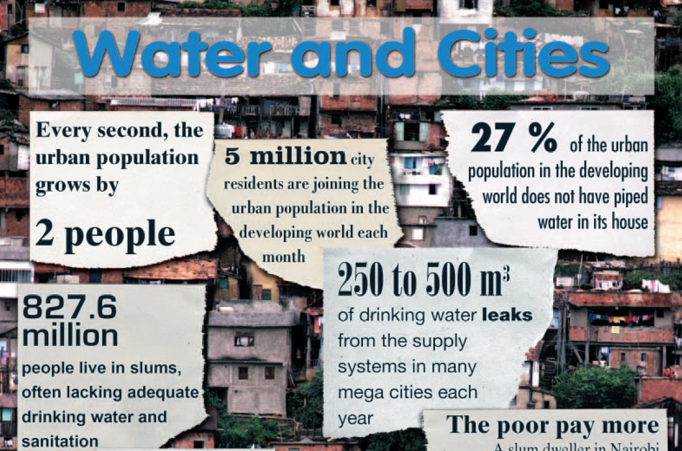
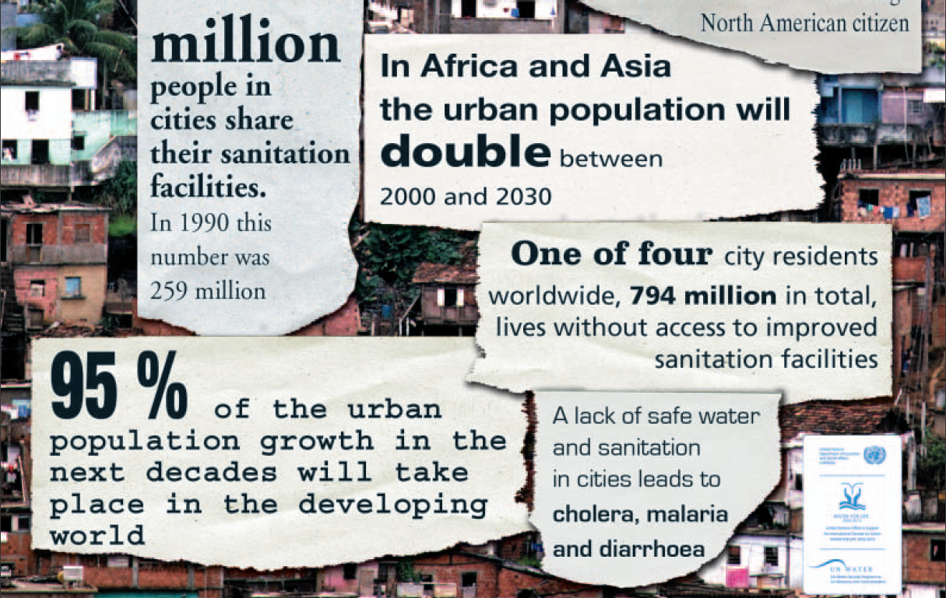

Slide 3


How much water do we use?
On average each person in the UK uses 155 litres of water per day.
50 litres
100 litres
155 litres
255 litres

Slide 4
Where do we use this water?
Activity | Litres used - per activity
Bath | 80 per bath
Flushing the toilet | 8 per flush
Shower | 35 per shower
Washing machine | 65 per wash
Dishwasher | 25
Cleaning teeth | 2

Slide 5
… in the rest of the world?
In developing countries average water use is 20 litres per day…
… for many it is even less

Slide 6
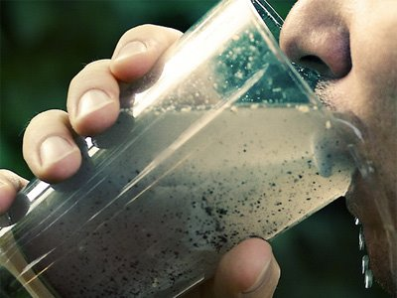
80% of illnesses in developing countries is caused by water related diseases.
The number of people with access to clean water has doubled in the last 20 years.
1.1 billion people in the world still do not have access to safe water. This is nearly 20% of the population.
The UN estimates that by 2025, 75% of the world population won’t have reliable, clean water.

Slide 7
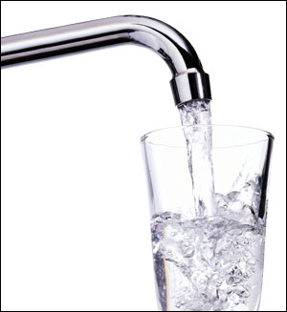
How much water do we need?
We need to drink 1 ½ litres of clean water a day to stay healthy and hydrated.

Slide 8
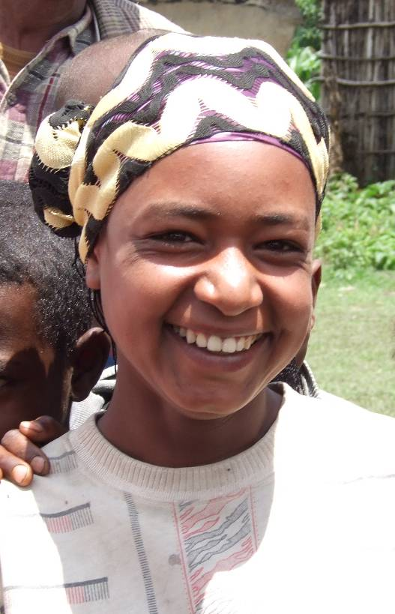
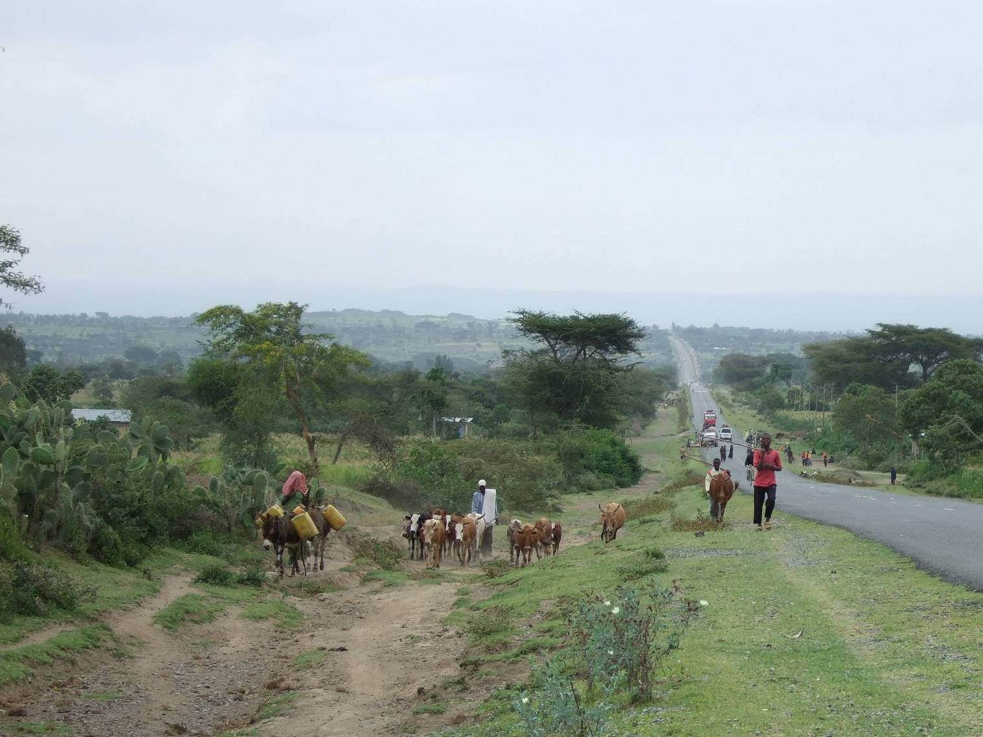
Munisa Nesere

Slide 9
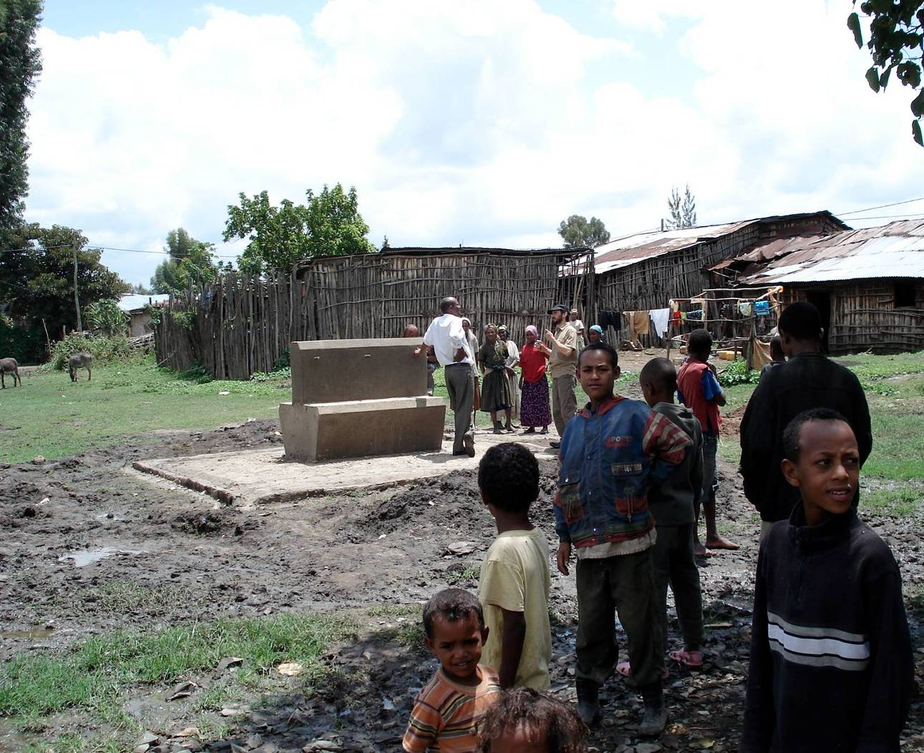

Slide 10
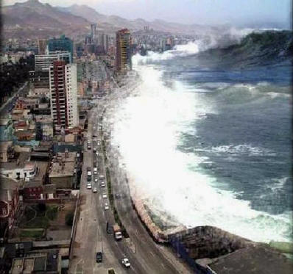
8,000
http://www.bbc.co.uk/news/world-asia-pacific-12791061

Slide 11
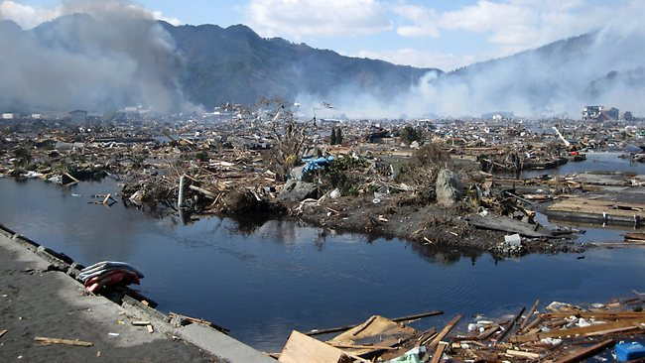
12,000

Slide 12
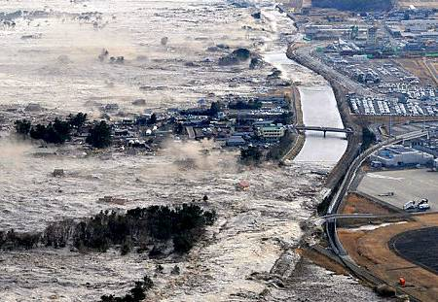
100,000

Slide 13
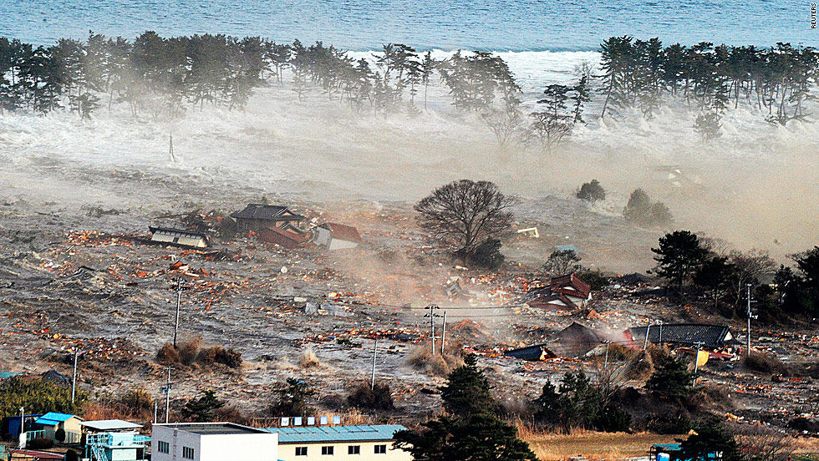

Slide 14
Response:
Lord, we pray for those all who suffer and grieve.
We give thanks to all who offer help and support.

Slide 15
Response:
Lord, we thank you for the gift of clean water
and pray that all will soon receive it.

