Slide 1

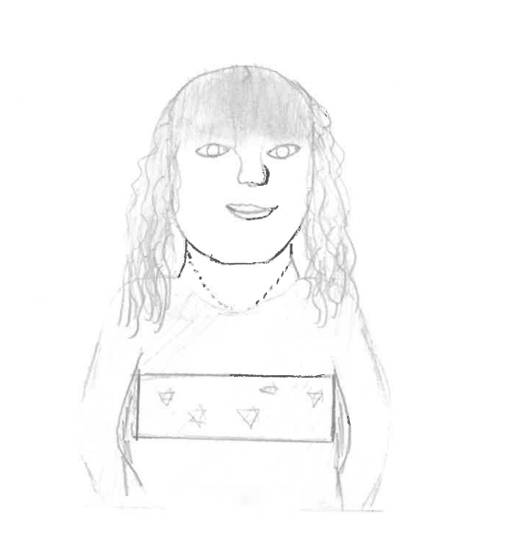
My name is Caroline and I have been a governor for over 12 years, joining Kingsway Junior School's Full Governing Body in September 2024. I was duly elected as Chair of Governors in the October and have settled into the role extremely well, visiting the School on numerous occasions to meet pupils, parents and staff with a view to finding out how the Governing Body can support Kingsway even more. I am a fully qualified teacher with more than 25 years’ experience working across the state, private and charity sectors and I am delighted to bring my many years of experience, as well as my knowledge and skills, to the entire Kingsway Community. I have lived in Hertfordshire for over 20 years with my French husband and our three children, all of whom were educated in an Infants and, then, Junior school in the county and had very positive experiences. Education and enhancing the education experience of young people is a passion of mine and I am looking forward to continuing to work with all members of the Kingsway Junior School Community for the good of our pupils and school.

Slide 2
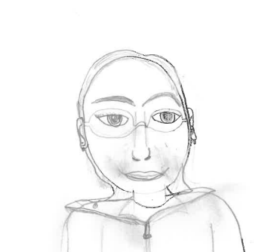
My name is Zoe and I have been a Governor at Kingsway Junior School since September 2019. My husband attended the school some years ago and I have an older child who has already gone through the Junior school and another child who is currently at the school. As a dedicated Governor, I am committed to ensuring the safety and wellbeing of all young people through my role as Governor with responsibility for Safeguarding and I regularly attend during the school day to observe and review the school’s many actions within this area. Over the past few years, my Governor role has also seen me actively involved in redesigning and redeveloping the swimming pool provision, aiming to enhance the facilities and provide a better experience for our young people. I have been particularly keen to ensure that this provision will be available for many years to come. My passion for welfare drives me to make sure that all members of the school community receive the correct support they need.

Slide 3
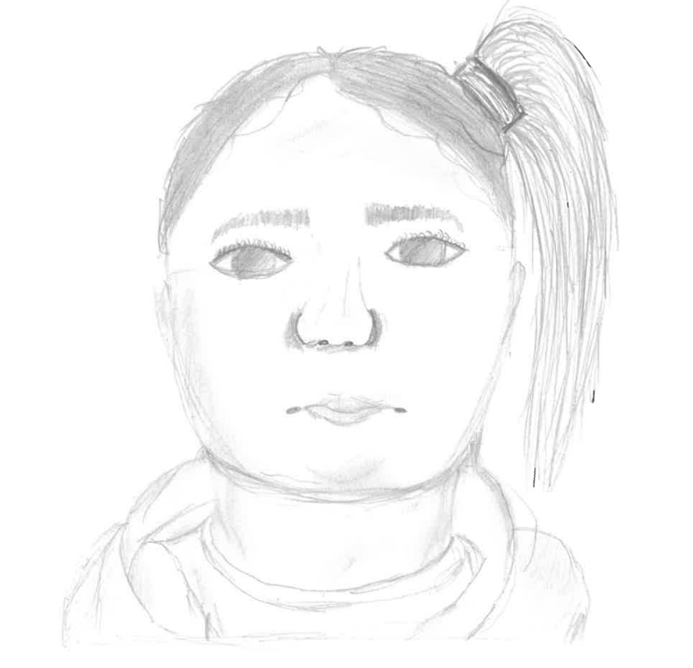
My name is Paula. I joined Kingsway as a Governor in February 2012, initially as a Parent Governor when my daughter started at the school and I am now a Co-opted Governor. I'm currently the Governor with responsibility for Health and Safety which is a priority at Kingsway Junior School. I have worked in Early years for over 25 years, as both the Deputy Manager at a Nursery and, now as a Childminder.

Slide 4
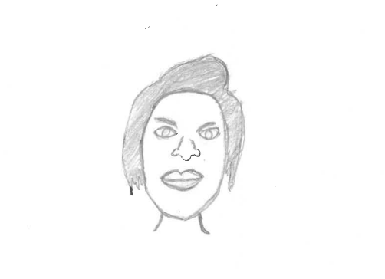
My name is Sue and I am a divorced mother of one. I became a Governor in July 2025, choosing to join because I realise the importance of education, having nurtured my dyslexic/ADHD daughter through state schools, to achieving a 2:1 master's degree in Chemical Engineering. I passionately believe that adults should not limit expectations of a child’s potential and I am keen to use my lived, professional experiences to help shape the education and environment of Kingsway pupils, who are today's society citizens and tomorrow's society decision makers. I have spent over 40 years in finance, undertaking specialist HR roles including training delivery, recruitment, investigations and disciplinaries. I am a qualified HR professional whose membership body demands that all members make ethical decisions and act with integrity, all of which are qualities that Sue, hopes, along with her mediation skills, will help her collaborate with the rest of the Governing Body, for the benefit of Kingsway.

Slide 5
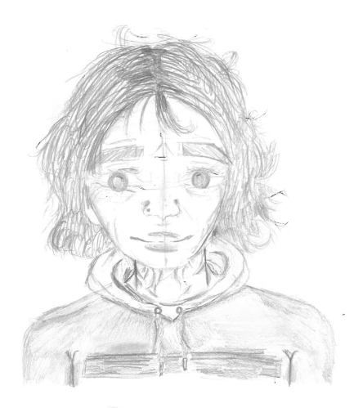
My name is Sandy and I became a Governor at Kingsway in December 2024. I was a primary school teacher for over ten years, teaching in Year 4. Then I became a private tutor to school children in Years 3 to 6, also, for over ten years. I have two daughters, two young grandsons but no pets! I am so excited and eager to bring my experience and knowledge to Kingsway Junior School.

Slide 6
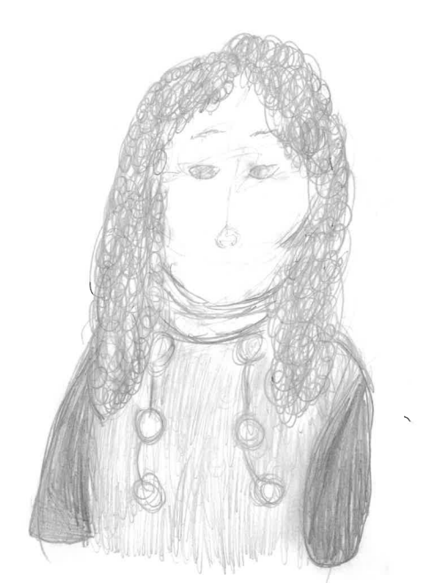
My name is Tina and I have worked with Children and Families for nearly 30 years, originally as a Nursery Nurse and, then, as a Children’s Centre Co-ordinator in London and Hertfordshire. I joined Kingsway Junior School as an Admin Assistant in 2018 and, in 2022, I became the Office Manager. I really enjoying working at Kingsway Junior, as I see the wonderful impact the Staff at our School have on the children and families. I am honoured to be part of the Governors Team. I am mum to two teenagers and have been married to my husband for over 20 years. In my spare time I enjoy cake making, crafting and DIY.

